Slide 1
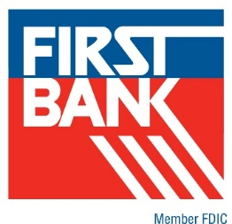
Center for Family Owned Business
PPP Webinar Series
Tim Fogerty, Managing Director- First Bank
Kate Mayfield, Director- First Bank
January 15, 2021

Slide 2
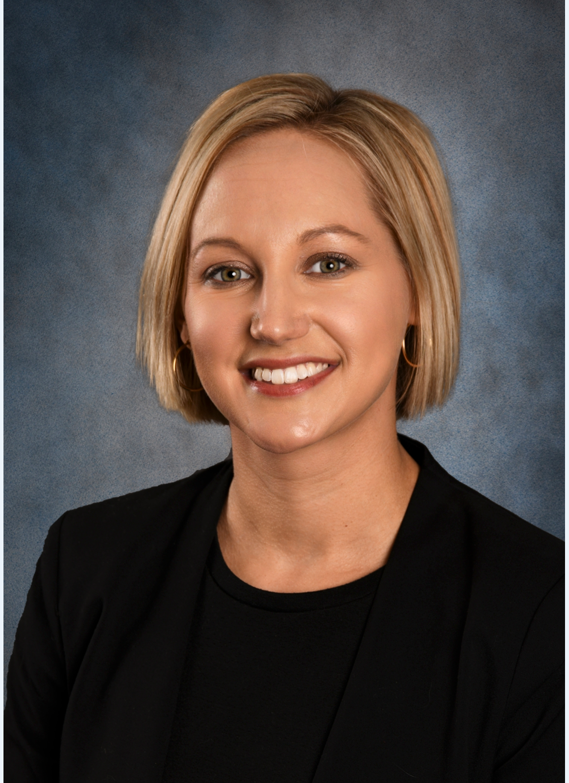
Presenters:
Tim Fogerty, Managing Director, Commercial Banking- First Bank
Kate Mayfield, Director, Credit and Underwriting- First Bank

Slide 3
AGENDA
Economic Aid Act Updates
Second Draw Loans- First Bank Process

Slide 4
Disclaimer
This presentation is furnished for informational use only. It is not intended to be comprehensive, nor does it constitute legal, accounting, tax or other professional advice. We encourage you to consult with your legal, tax and/or accounting professional for specific advice. This presentation is based on information available as of the first date and time of delivery of this presentation. Due to the evolving nature of the regulations and agency guidance addressing the Paycheck Protection Program, all information in this presentation is subject to change without notice.
First Bank recommends a thorough review of the CARES Act, PPP Flexibility Act, Economic Aid Act, and SBA Interim Final Rules, these documents can be found at First.Bank

Slide 5
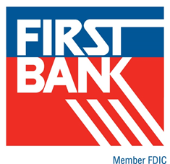
Economic Aid Act: Clarification of Income Taxes Related to PPP Loan Forgiveness
The provision clarifies that gross income does not include any amount that would otherwise arise from the forgiveness of a Paycheck Protection Program (PPP) loan.
This provision also clarifies that deductions are allowed for otherwise deductible expenses paid with the proceeds of a PPP loan that is forgiven, and that the tax basis and other attributes of the borrower’s assets will not be reduced as a result of the loan forgiveness.
The provision also clarifies that gross income does not include forgiveness of certain loans, EIDL Grants and Grants for Shuttered Venue Operators.
Effective as of the date of the CARES Act (March 2020) and applies to all PPP and 2nd Draw PPP loans.
Questions regarding this change should be directed to your tax advisor

Slide 6
Economic Aid Act: Simplified Forgiveness
Forms for PPP Borrowers of $150,000 and below
Simplified application for loans under $150,000 (previously <= $50,000), with requirements & limitations including:
  Borrower will receive forgiveness if a one page certification is provided to the lender that all funds were used consistent with program guidelines.
  The certification will include a description of number of employees, estimated loan amount spent on payroll and total loan amount.
  Records are required to be retained by borrower for up to 4 years.
  All PPP loans not previously forgiven will be eligible for short form forgiveness.
Forgiveness application form from the SBA, estimated as due on January 29th, with First Bank implementation shortly thereafter.
If you have already received a First Bank forgiveness form and have not submitted you can request the new form once it is available.
If First Bank has submitted your forgiveness application to the SBA, you do not need to resubmit.

Slide 7
Economic Aid Act: Economic Injury Disaster Loan
SBA will no longer deduct Economic Injury Disaster Loan (EIDL) advances from forgiveness payment.
If lender has already received a forgiveness payment net of an EIDL advance, SBA will provide a reconciliation payment to lender to be applied to the outstanding loan balance.
More details are expected from the SBA on the timing of the reconciliation payments.
First Bank has suspended client payments on post-forgiveness PPP loans with EIDL residual balances.

Slide 8
Economic Aid Act: Ability for PPP Borrowers to Request an Increase in Loan Amount
Borrowers who proactively returned all or part of their PPP loan to reapply for the maximum amount applicable so long as forgiveness has not been received.
Borrowers whose loan calculations have increased due to changes in interim final rules throughout the PPP process can work with Lenders to modify their loan value regardless of whether loan has been fully disbursed.
The SBA has not yet given any guidance on application for this provision. Applications are not being taken at this time.

Slide 9
Economic Aid Act
PPP First Draw Loans
PPP Second Draw Loans

Slide 10
Economic Aid Act: First Draw PPP Loan
Available if you have not received a PPP loan.
Allows up to 500 employees.
Expands allowable usage of PPP proceeds.
Expands eligible borrowing entities.
Program is expected to open to larger financial institutions on Tuesday, January 19th.
Program ends March 31, 2021

Slide 11
Economic Aid Act: Second Draw PPP Loan
The Paycheck Protection Program (PPP) now allows certain eligible borrowers that previously received a PPP loan to apply for a Second Draw PPP loan with the same general loan terms as their First Draw PPP loan.
Program is expected to open to larger financial institutions on Tuesday, January 19th.
Program ends March 31, 2021

Slide 12
Economic Aid Act: PPP Borrower Eligibility
Who can apply for First Draw or Second Draw PPP loan:
Business Entities (partnerships, corporations, LLC)
Sole Proprietors, independent contractors, self employed individuals
501 (c)(3)
501 (c) (6) (new)
501 (c)(19)
Veterans organizations, Tribal businesses, housing cooperatives, destination marketing organizations, and eligible news organizations (new)
Note: a listing of ineligible borrowers can be found in the appendix.

Slide 13
Second Draw PPP Borrower Loan Eligibility
Previously received a First Draw PPP loan and will or has used the full amount only for authorized uses. All PPP loan proceeds must be spent prior to disbursement on Second Draw PPP loans.
Has no more than 300 employees with certain exceptions for NAICS code 72, Food and Accommodation, and eligible news organizations which are allowed 300 employees per location.
Can demonstrate at least a 25% reduction in gross receipts* between comparable quarters in 2019 and 2020.
Second Draw loans are limited to $2,000,000.
Total PPP loans (First Draw plus Second Draw limited to $10,000,000).
  *see appendix for SBA definition of gross receipts

Slide 14
Second Draw PPP Loans
Revenue Reduction Requirement
A borrower must calculate this revenue reduction by comparing the borrower’s quarterly gross receipts* for one quarter in 2020 with the borrower’s gross receipts* for the corresponding quarter of 2019.
For example, a borrower with gross receipts* of $50,000 in the second quarter of 2019 and gross receipts* of $30,000 in the second quarter of 2020 has experienced a revenue reduction of 40 percent between the quarters, and is therefore eligible for a Second Draw PPP loan (assuming all other eligibility criteria are met).
Borrower must use calendar quarter, not fiscal quarter.
* see appendix for SBA definition of gross receipts

Slide 15
Second Draw PPP Loans
Revenue Reduction Requirement
Subsection (c)(1)(iv)(B) of the IFR provides that a borrower that was in operation in all four quarters of 2019 is deemed to have experienced the required revenue reduction if it experienced a reduction in annual receipts of 25 percent or greater in 2020 compared to 2019 and the borrower submits copies of its annual tax forms substantiating the revenue decline.
This method will be particularly important for small borrowers that may not have quarterly revenue information readily available.

Slide 16
Second Draw PPP Loans
Revenue Reduction Requirement
PPP loans over $150,000 are required to provide documentation supporting the 25% revenue decline with the application.
PPP loans of $150,000 and below are not required to provide documentation at application but will be required to provide supporting documentation for forgiveness.

Slide 17
Second Draw PPP Loans:
Maximum Loan Amount & Increased Assistance for Accommodation and Food Service Businesses
For most borrowers, the maximum loan amount of a Second Draw PPP loan is 2.5x average monthly 2019 or 2020 payroll costs up to $2 million.
For borrowers in the Accommodation and Food Services sector NAICS 72* as reported per your tax return, the maximum loan amount for a Second Draw PPP loan is 3.5x average monthly 2019 or 2020 payroll costs up to $2 million.
Section 317 of the Economic Aid Act modified this provision for Second Draw PPP loans by reducing the limit on employees per physical location to 300.
* see Appendix for listing of NAICS 72 codes

Slide 18
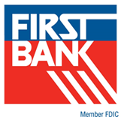
Economic Aid Act: Allowable Uses for Loan Proceeds for First Draw and Second Draw Loans
Payroll Costs*
Mortgage Interest
Rent
Utilities
Worker Protection Costs related to COVID-19* (new)
Uninsured property damage costs caused by looting or vandalism during 2020* (new)
Certain Supplier Costs and Expenses for Operation* (new)
* see appendix for detailed information regarding these allowable costs

Slide 19
Second Draw PPP Loans: Terms & Conditions
Generally the same terms, conditions, and requirements as the First Draw PPP loans.
The SBA guarantee is 100%.
No collateral required.
No personal guarantees required.
Interest Rate: 100 basis points or one percent, calculated on non-compounding, non-adjustable basis.
Maturity: 5 years
Principal and interest deferred for 10 months after the end of the selected coverage period up to 24 weeks.

Slide 20
Second Draw PPP Loans: Full Forgiveness Terms
Second Draw PPP loans made to eligible borrowers qualify for full loan forgiveness if during the 8-to-24 week covered period following loan disbursement.
Employee count and compensation levels are maintained in the same manner as required for First Draw PPP loans.
The loan proceeds are spent on payroll costs and other eligible expenses.
At least 60% of the loan proceeds are spent on payroll costs.

Slide 21
PPP Loan Necessity Certification
31.Question: Do businesses owned by large companies with adequate sources of liquidity
to support the business’s ongoing operations qualify for a PPP loan?
Answer: In addition to reviewing applicable affiliation rules to determine eligibility, all borrowers must assess their economic need for a PPP loan under the standard established by the CARES Act and the PPP regulations at the time of the loan application.
Although the CARES Act suspends the ordinary requirement that borrowers must be unable to obtain credit elsewhere (as defined in section 3(h) of the Small Business Act), borrowers still must certify in good faith that their PPP loan request is necessary. Specifically, before submitting a PPP application, all borrowers should review carefully the required certification that current economic uncertainty makes this loan request necessary to support the ongoing operations of the Applicant.
Borrowers must make this certification in good faith, taking into account their current business activity and their ability to access other sources of liquidity sufficient to support their ongoing operations in a manner that is not significantly detrimental to the business.
For example, it is unlikely that a public company with substantial market value and access to capital markets will be able to make the required certification in good faith, and such a company should be prepared to demonstrate to SBA, upon request, the basis for its certification.
  SBA FAQ as of October 7, 2020

Slide 22
First Bank PPP Process
Borrower contacts Relationship Manager- Branch Manager to request application
After e-Signed application is received, First Bank reviews submission for completeness – resolves any issues with borrower
First Bank officer provides link to application portal
Borrower completes loan application and certifications
First Bank sends DocuSign envelope – Borrower e-signs application

Slide 23
First Bank PPP Process
First Bank submits loan request to SBA
SBA provides approval and provides SBA loan number to First Bank
First Bank completes loan documentation and sends to borrower via DocuSign
Borrower e-Signs First Bank loan documents
Upon receipt of loan documents First Bank funds the borrower’s account at First Bank

Slide 24
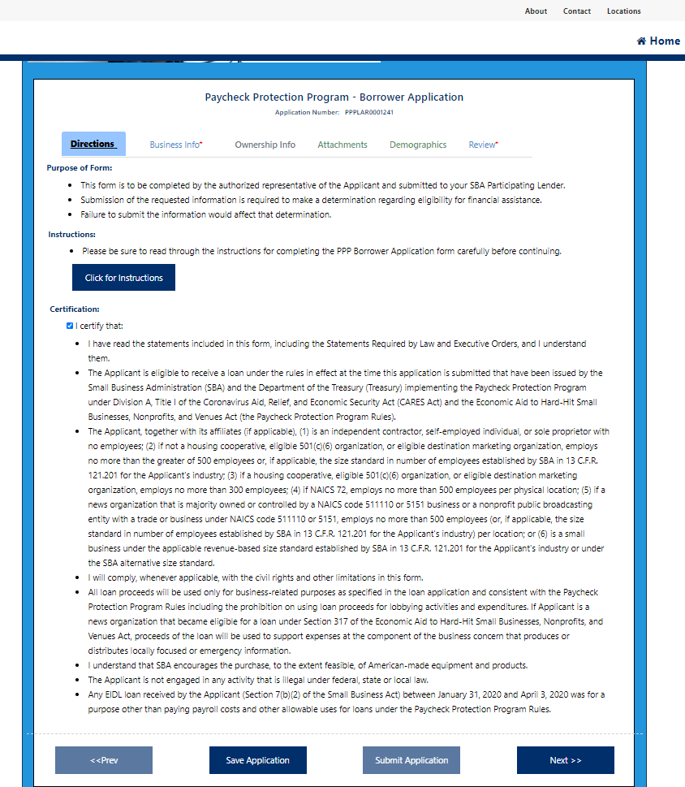

First Bank Portal
Overview
Overview:
Once a client enrolls in the portal, they will complete each tab.
Ability to save and return to the portal at anytime.
Options to click through for SBA instructions and definitions.
(Blue Boxes that indicate click here)
Asterisks indicate required fields
indicates additional information available
All fields correspond with fields on SBA loan forms
Tab 1 Directions:
Review all certifications and check Certify Box.

Slide 25
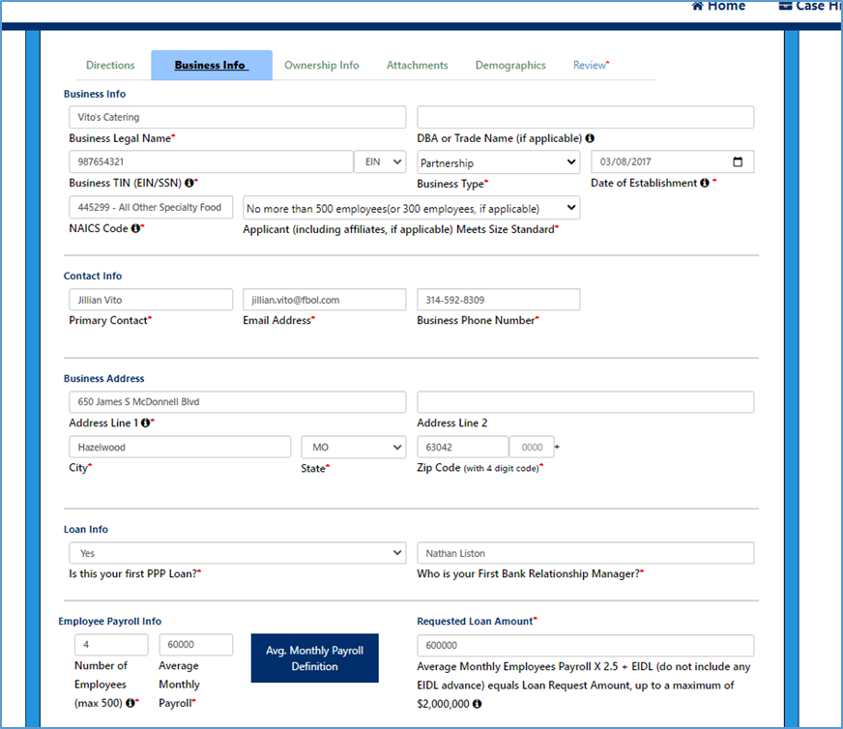
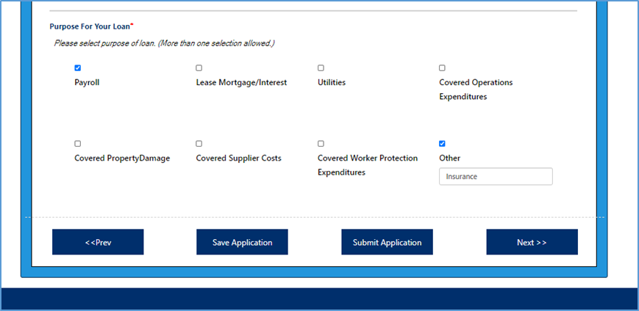
First Bank Portal
Overview
Tab 2 Business Info:
1) General Business Info:
  Complete all required fields
  NAICS codes available by clicking
2) Loan Info (red box)
  Is this First Loan ? Y/N drop down
This response provides the appropriate
fields to the applicant
  Requires Relationship Manager Name
3) Payroll Info
  Average Monthly Payroll Definition
(red box) provides SBA definition
4) Purpose for loan (select all that apply)

Slide 26
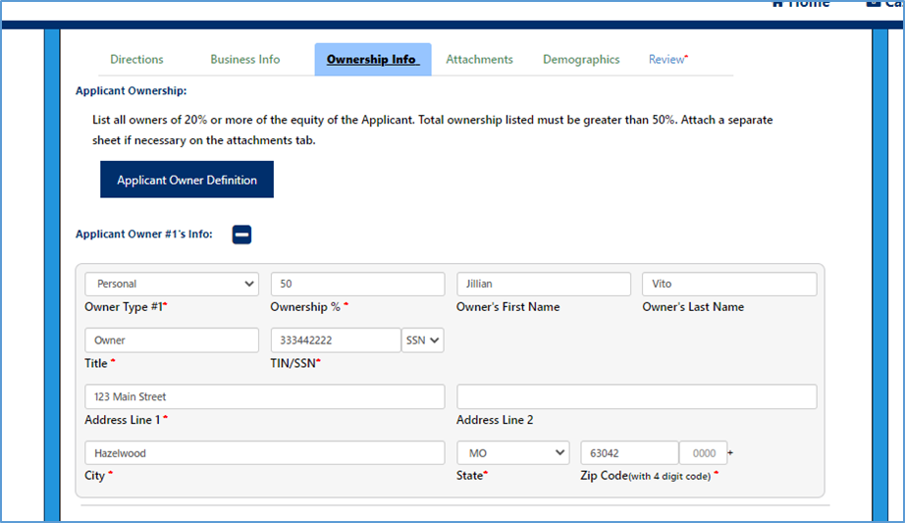
First Bank Portal
Overview
Tab 3 Ownership Info :
Overview:
Requires information of all owners greater than 20%
Must document ownership of at least 5o%
Ownership Type: Person or Business
Applicant Owner button (red box) provides SBA definition of owner

Slide 27
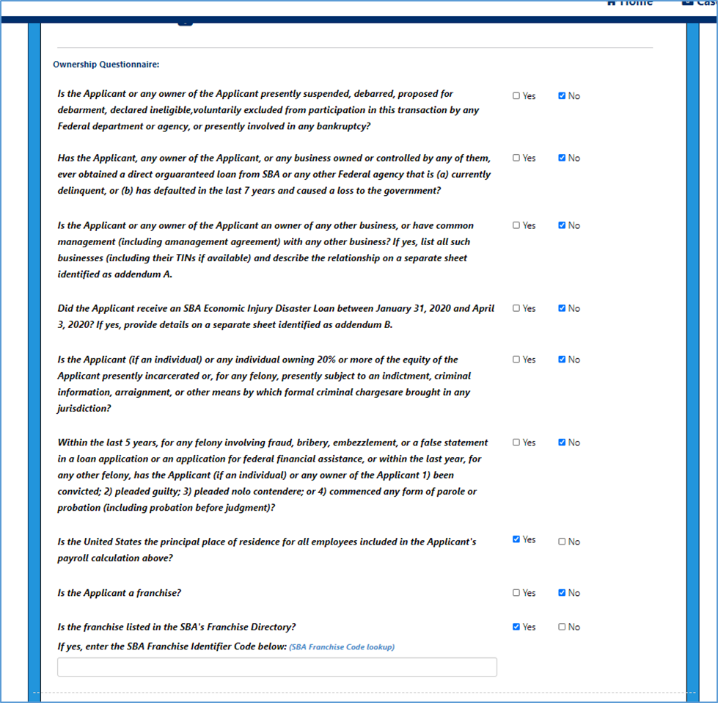
First Bank Portal
Overview
Tab 3 Ownership Questionnaire :
After completing ownership information, applicants will complete questionnaire
Applicants select Yes or No for each question

Slide 28
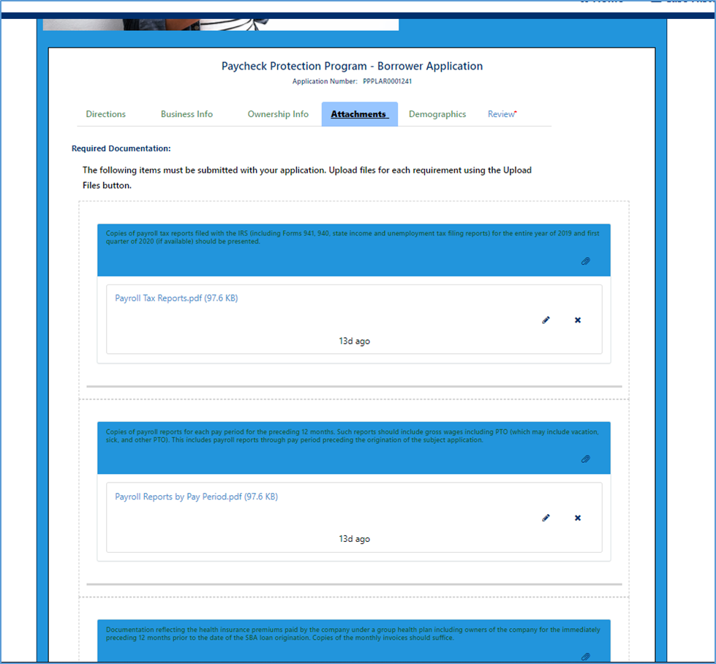
First Bank Portal
Overview
Tab 4 Attachments:
Applicants will load attachments
In the proper fields
First Bank will validate the
attachments and contact
Applicant for additional
information
Requests for additional documentation or clarification of application between First Bank and Applicant will occur through the Portal

Slide 29
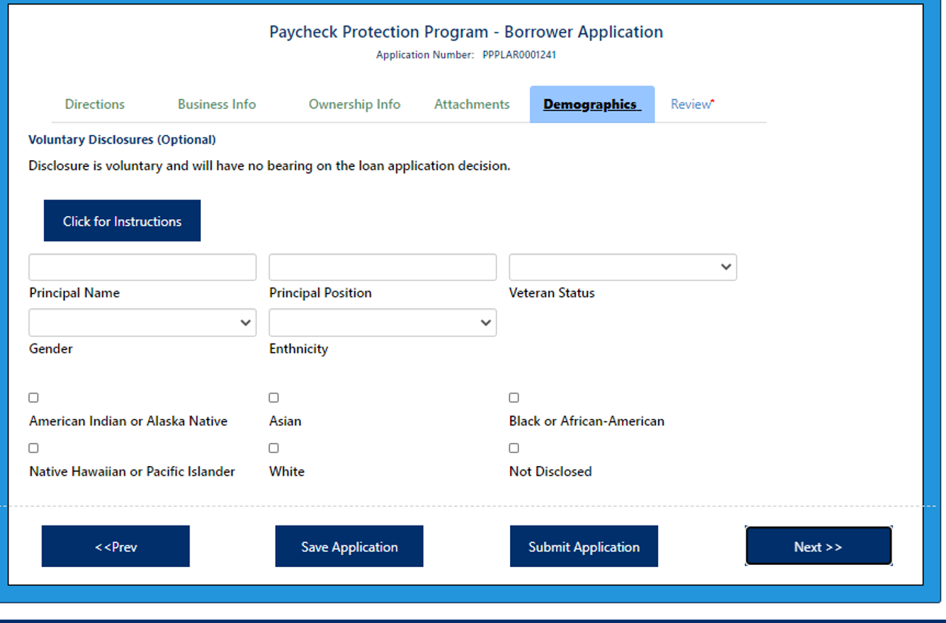
First Bank Portal
Overview
Tab 5 Demographic Info:
Borrowers may complete the
optional demographic
information
Additional SBA Information regarding Demographic Information collection available in the click for instructions box

Slide 30
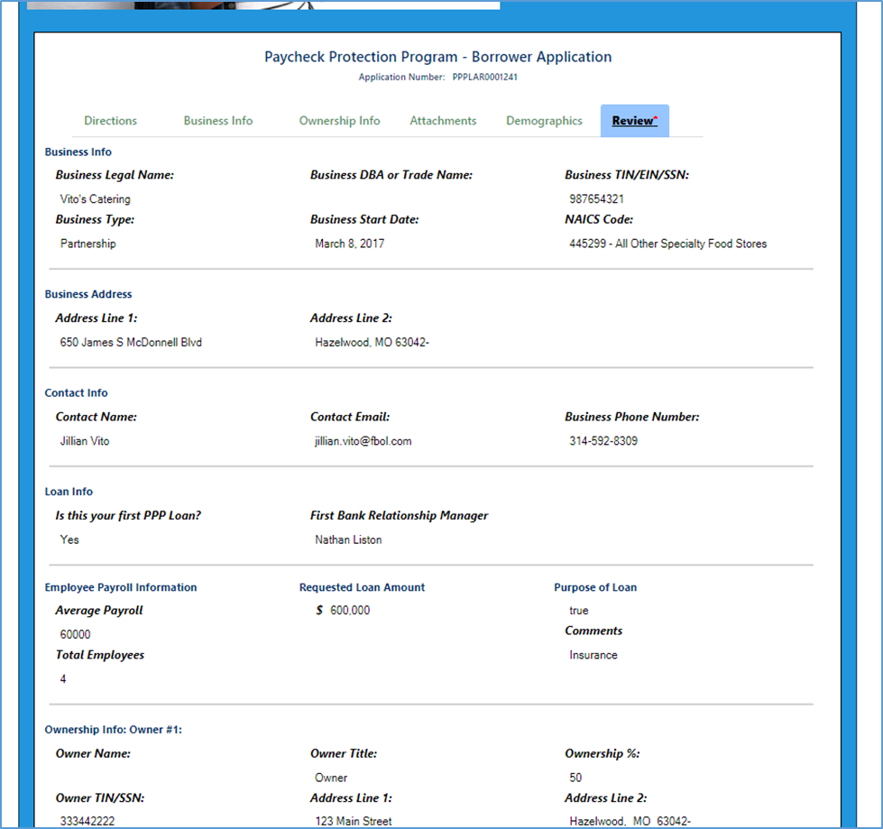
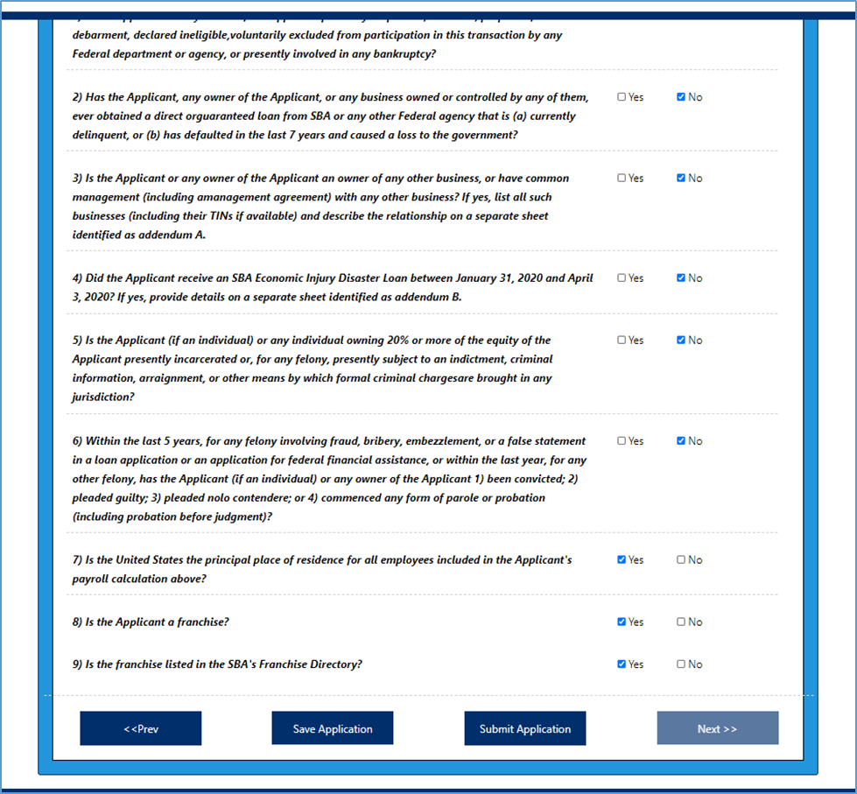
First Bank Portal
Overview
Tab 6: Review
Applicants will review final application before submitting application.
click Submit Application Button

Slide 31
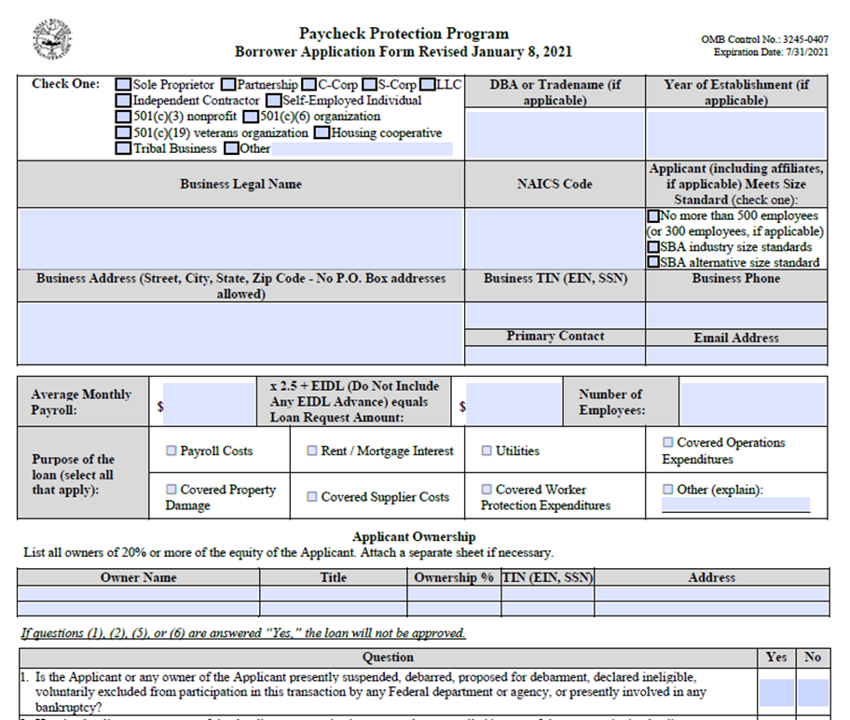
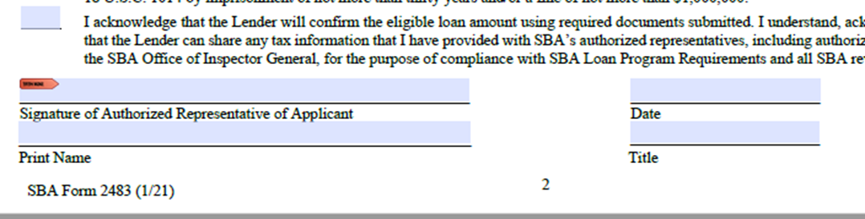
First Bank Portal to
SBA Application
Next Step:
Applicants will receive a DocuSign envelope to complete the application submission process
All information entered through the Portal will be loaded into the SBA Borrower Application (Form 2483) for eSignature.
Applicant must complete the eSignature process in DocuSign in order to complete the application process with First Bank.

Slide 32

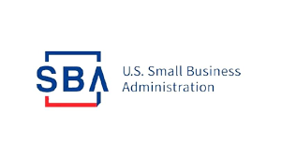
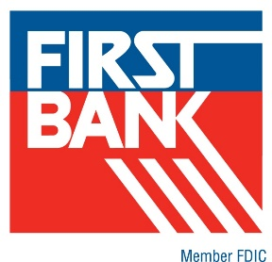
Resources
US Department of Treasury https://home.treasury.gov/
Small Business Association https://www.sba.gov/
First Bank’s COVID-19 web page
https://www.first.bank/

Slide 33
Appendix

Slide 34
Gross Receipts: SBA Definition
Subsection (c)(2) of the IFR generally defines gross receipts to include all revenue in whatever form received or accrued (in accordance with the entity’s accounting method) from whatever source, including from the sales of products or services, interest, dividends, rents, royalties, fees, or commissions, reduced by returns and allowances. Generally, receipts are considered “total income” (or in the case of a sole proprietorship, independent contractor, or self-employed individual “gross income”) plus “cost of goods sold,” and excludes net capital gains or losses as these terms are defined and reported on IRS tax return forms.
Gross receipts do not include the following: taxes collected for and remitted to a taxing authority if included in gross or total income (such as sales or other taxes collected from customers and excluding taxes levied on the concern or its employees); proceeds from transactions between a concern and its domestic or foreign affiliates; and amounts collected for another by a travel agent, real estate agent, advertising agent, conference management service provider, freight forwarder or customs broker. All other items, such as subcontractor costs, reimbursements for purchases a contractor makes at a customer's request, investment income, and employee-based costs such as payroll taxes, may not be excluded from gross receipts. Subsection (c)(2) also adapts the methodology for calculating affiliate receipts from 13 C.F.R. 121.104.
The IFR specifies that any forgiveness amount of a First Draw PPP Loan that a borrower received in calendar year 2020 is excluded from a borrower’s gross receipts

Slide 35
NAICS 72: Accommodation and Food Services
Code | Description | Code | Description
7211 | Traveler Accommodation | 7223 | Special Food Services
721110 | Hotels (except Casino Hotels) and Motels | 722310 | Food Service Contractors
721120 | Casino Hotels | 722320 | Caterers
721191 | Bed and Breakfast Inns | 722330 | Mobile Food Services
721199 | All Other Traveler Accommodations | 7224 | Drinking Places (Alcoholic Beverages)
7212 | RV (Recreational Vehicle) Parks and Recreational Camps | 722410 | Drinking Places (Alcoholic Beverages)
721211 | RV Parks and Campgrounds | 7225 | Restaurants and other Eating Places
721214 | Recreational and Vacation Camps (except campgrounds) | 722511 | Full-Service Restaurants
7213 | Rooming and Boarding Houses, Dormitories, and Workers’ Camp | 722513 | Limited-Service Restaurants
721310 | Rooming and Boarding Houses, Dormitories, and Workers’ Camp | 722514 | Cafeterias, Grill Buffets, and Buffets
 |  | 722515 | Snack and Nonalcoholic Beverage Bars

Slide 36
Economic Aid Act: Payroll Cost
Payroll costs consist of compensation to employees (whose principal place of residence is the United States) in the form of salary, wages, commissions, or similar compensation; cash tips or the equivalent (based on employer records of past tips or, in the absence of such records, a reasonable, good-faith employer estimate of such tips); payment for vacation, parental, family, medical, or sick leave (except those paid leave amounts for which a credit is allowed under FFCRA Sections 7001 and 7003); allowance for separation or dismissal;
Payment for the provision of employee benefits consisting of group health care coverage (including insurance premiums), group life, disability, vision, or dental insurance, and retirement benefits; payment of state and local taxes assessed on compensation of employees; and, for an independent contractor or sole proprietor, wage, commissions, income, or net earnings from self-employment or similar compensation.
For purposes of calculating “Average Monthly Payroll,” most Applicants will use the average monthly payroll for 2019 or 2020, excluding costs over $100,000 on an annualized basis ($20,833.33).

Slide 37
Payroll Cost Calculation
In general, section 307 of the Economic Aid Act provides that the maximum loan amount for a Second Draw PPP Loan is equal to the lesser of two and half months of the borrower’s average monthly payroll costs or $2 million. Relative to First Draw PPP loans, the Economic Aid Act adjusted the methodology for calculating a borrower’s payroll costs. Unlike First Draw PPP Loans, the Economic Aid Act provides that the relevant time period for calculating a borrower’s payroll costs for a Second Draw PPP Loan is either the twelve-month period prior to when the loan is made or calendar year 2019
The Act also provided tailored methodologies for certain categories of borrowers. These calculations are reflected in subsection (f) of this IFR. Subsection (f) of the IFR uses “calendar year 2020” to refer to “the twelve-month period prior to when the loan is made.” Calculating payroll costs based on calendar year 2020 rather than the twelve months preceding the date the loan is made will simplify the calculations and documentation requirements for borrowers because payroll records are more commonly created and retained on a calendar-year basis. Allowing borrowers to calculate payroll costs based on calendar year 2020 is also not expected to result in a significant difference in payroll costs compared to the twelve months preceding the date the loan is made because all Second Draw PPP Loans will be made in the first quarter of 2021. However, the rule notes that Second Draw PPP Loan borrowers who are not self-employed (including sole proprietorships and independent contractors) are also permitted to use the precise 1-year period before the date on which the loan is made to calculate payroll costs if they choose not to use 2019 or 2020 to calculate payroll costs.

Slide 38
Second Draw PPP Loans: Excluded Entities
The Economic Aid Act also prohibits several additional categories of borrowers from receiving a Second Draw PPP Loan under section 7(a)(37) of the Small Business Act. These categories of prohibited borrowers are listed in subsection (e) of the IFR:
  a business concern or entity primarily engaged in political activities or lobbying activities, including any entity that is organized for research or for engaging in advocacy in areas such as public policy or political strategy or that describes itself as a think tank in any public documents;21
  certain entities organized under the laws of the People’s Republic of China or the Special Administrative Region of Hong Kong, or with other specified ties to the People’s Republic of China or the Special Administrative Region of Hong Kong
  any person required to submit a registration statement under section 2 of the Foreign Agents Registration Act of 1938 (22 U.S.C. 612)
  a person or entity that receives a grant for shuttered venue operators under section 324 of the Economic Aid Act
  Entities in which the President, the Vice President, the head of an Executive department, or a Member of Congress, or the spouse of such person owns, controls, or holds at least 20 percent of any class of equity;
  a publicly traded company, defined as an issuer, the securities of which are listed on an exchange registered as a national securities exchange under section 6 of the Securities Exchange Act of 1934 (15 U.S.C. 78f).
  Subsection (e)(9) also prohibits an entity that has permanently closed from receiving a Second Draw PPP Loan because paragraph 7(a)(37)(A)(iv) of the Small Business Act is best understood to describe existing businesses

Slide 39
Economic Aid Act: Allowable Costs
Section 308: Specific Group Insurance Payments as Payroll Costs
  Clarifies that other employer-provided group insurance benefits are included in payroll, including group life, disability, vision, or dental insurance. Effective date retroactive to CARES Act (March 2020)
Section 304: Additional Eligible Expenses
  Covered Operations Expenditures: payment for any software, cloud computing, and other human resources and accounting needs.
  Covered Property Damage Costs: costs related to property damage due to public disturbances that occurred during 2020 that are not covered by insurance.
  Covered Supplier Costs: expenditures to a supplier pursuant to a contract, purchase order, or order for goods in effect prior to taking out the loan that are essential to the recipient’s operations at the time at which the expenditure was made. Supplier costs of perishable goods can be made before or during the life of the loan.
  Covered Worker Protection Expenditure: personal protective equipment and adaptive investments to help a loan recipient comply with federal health and safety guidelines or any equivalent State and local guidance related to COVID-19 during the period between March 1, 2020, and the end of the national emergency declaration.

Slide 40
Thank You

